Slide 1
Module 03: Deploy & Manage Azure Compute Resources

Slide 2
Lesson 1 – Virtual Machines

Slide 3
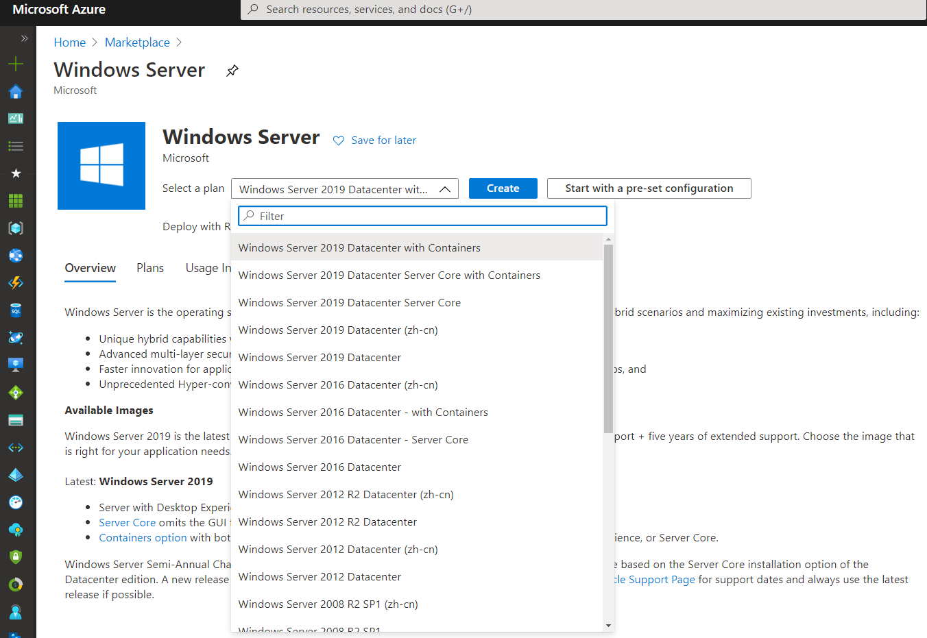
Creating Virtual Machines – Portal
There are multiple ways to create a Virtual Machine (VM) in Azure, the Azure Portal is one of them.
This method provides a browser-based, user interface to create VMs and their associated resources.

Slide 4
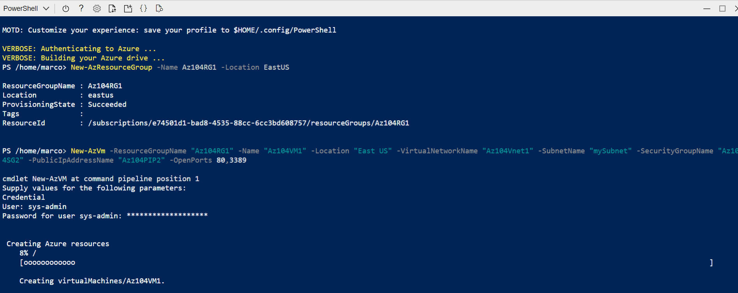
Creating Virtual Machines – PowerShell
The Azure PowerShell module is used to create and manage Azure resources from the PowerShell command line or in scripts.
The Azure Cloud Shell is a free interactive shell that users can use to run the management of their Azure Cloud environment, it has common Azure tools preinstalled and configured to use with their account.

Slide 5
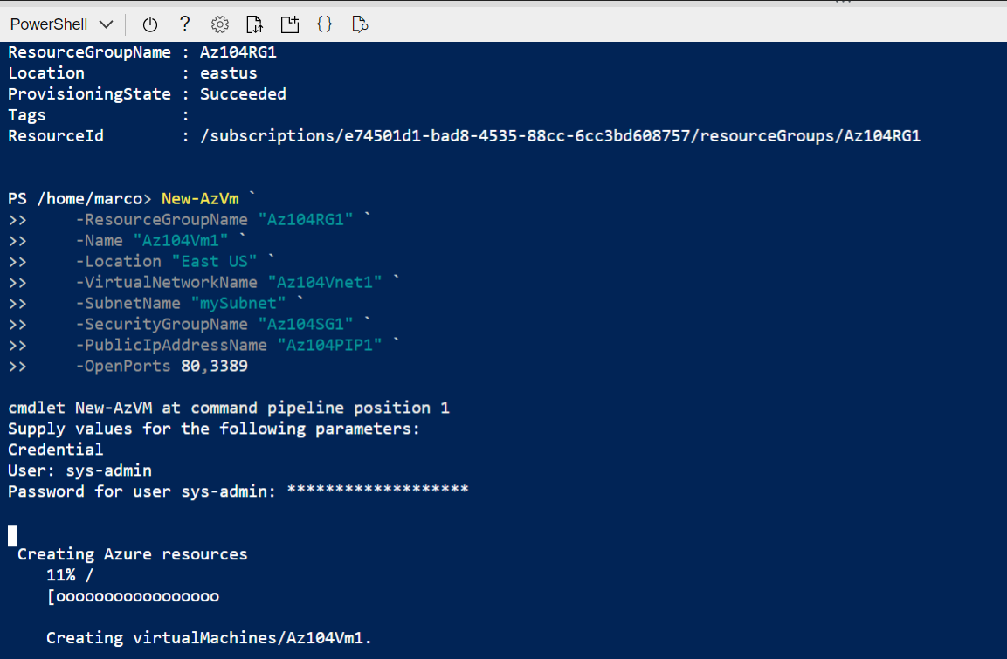
Creating Virtual Machines – CLI (Command Line Interface)
The Azure CLI is used to create and manage Azure resources from the command line or in scripts.
It has common Azure tools preinstalled and configured to use with the user account.

Slide 6
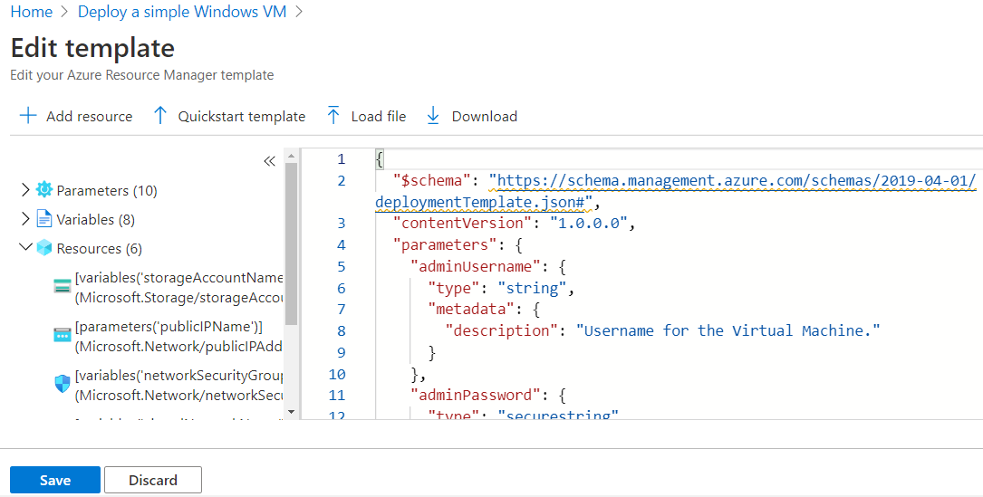

Creating Virtual Machines – Azure Resource Manager Template (ARM Template)
An ARM template is a JavaScript Object Notation (JSON) file that defines the infrastructure and configuration for the user project.
The template uses declarative syntax. In declarative syntax, users describe their intended deployment without writing the sequence of programming commands to create the deployment.

Slide 7
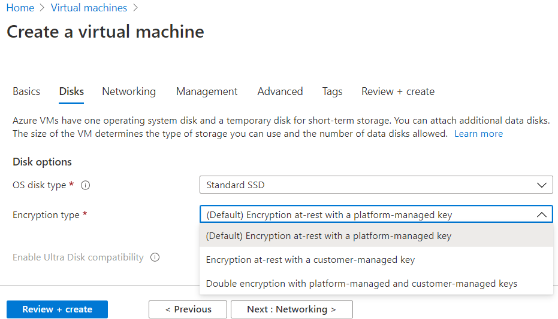
Configure Azure Disk Encryption
Azure Disk Encryption helps users to protect their data.
It uses the Bitlocker feature of Windows to provide volume encryption for the OS and data disks of Azure Virtual Machines (VMs) and it can be integrated with Azure Key Vault to help users control and manage the disk encryption keys and secrets.

Slide 8
Supported VMs – Disk Encryption
Windows VMs are available in a range of sizes.
Keep in mind, Azure Disk Encryption is not available on Basic, A-series VMs, or on Virtual Machines with a less than 2 GB of memory.
Azure Disk Encryption is also available for VMs with premium storage.
Azure Disk Encryption is not available on Generation 2 VMs.
Azure Disk Encryption is not available on VM images without temp disks (Dv4, Dsv4, Ev4, and Esv4).
Notes:
Supported operating systems
Windows client: Windows 8 and later.
Windows Server: Windows Server 2008 R2 and later.
Note
Windows Server 2008 R2 requires the .NET Framework 4.5 to be installed for encryption

Slide 9
Unsupported Scenarios – Disk Encryption
Azure Disk Encryption does not work for the following scenarios, features, and technology:
Integration with an On-Premise Key Management System
Azure Files (shared file system)
Network File System (NFS)
Dynamic Volumes
Windows Server Containers – which create dynamic volumes for each container
Moving Encrypted VMs to Another Subscription or Region
Creating an Image or Snapshot of an Encrypted VM and Using it to Deploy Additional VMs
M-Series VMs with Write Accelerator Disks
Migrating a VM that is encrypted with ADE, or has ever been encrypted with ADE, to server-side encryption with customer-managed keys.

Slide 10
Networking Requirements – Disk Encryption
To enable Azure Disk Encryption, the VMs must meet the following network endpoint configuration requirements:
To get a token to connect to the user key vault, the Windows VM must be able to connect to an Azure Active Directory endpoint, [login.microsoftonline.com].
To write the encryption keys to the user key vault, the Windows VM must be able to connect to the key vault endpoint.
The Windows VM must be able to connect to an Azure storage endpoint that hosts the Azure extension repository and an Azure storage account that hosts the VHD files.
If the user security policy limits access from Azure VMs to the Internet, users can resolve the preceding URI and configure a specific rule to allow outbound connectivity to the IPs.

Slide 11
How Disks are Used by VMs
VMs Use Disks for 3 Different Purposes:
Operating System Storage:
Every VM includes one disk that stores the operating system.
This drive is registered as a SATA drive and labeled as the C: drive in Windows and mounted at "/" in Unix-like operating systems.
Temporary Storage:
Every VM includes a temporary VHD that is used for page and swap files. Data on this drive may be lost during a maintenance event or redeployment.
The drive is labeled as D: on a Windows VM by default.
Do not use this drive to store important data that you do not want to lose.
Data Storage:
Users use data disks to store files, databases, and any other data that they need to persist across reboots.
Each data disk is registered as a SCSI drive and has a max capacity of 32,767 GiB.
Users can choose drive letters or mount points for their data drives.
Notes:
Operating system storage - It has a maximum capacity of 4,095 gibibytes (GiB), and its content is taken from the VM image you used to create the VM.
Temporary
Data storage - Some VM images include data disks by default. You can also add additional data disks up to the maximum number specified by the size of the VM.

Slide 12
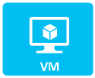

Adding Data Disks
Before users attach disks to their VM, they should review these tips:
The size of the virtual machine controls and how many data disks users can attach.
Disks attached to virtual machines are .vhd files stored in Azure.
After attaching the disk, users need to connect to the VM to mount the new disk.

Slide 13
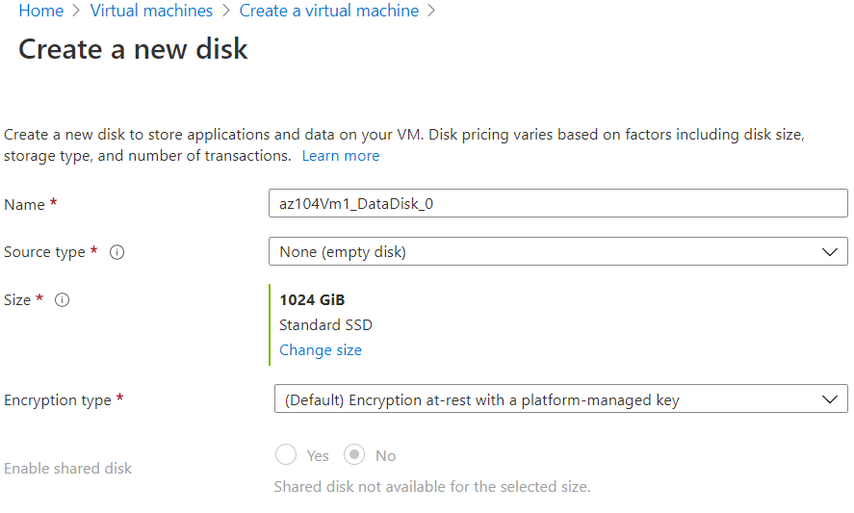
Attach Data Disks to VMs
Users can add data disks to a virtual machine at any time by attaching them to the VM. Attaching a disk will associate the VHD file with the VM.
The VHD can't be deleted from storage while it's attached.
The Add-AzVMDataDisk cmdlet adds a data disk to a virtual machine.
Users can add a data disk when they create a virtual machine, or they can add a data disk to an existing Virtual Machine.

Slide 14
Storing VHD Files
In Azure, VHDs are Stored in an Azure Storage Account as Page Blobs
Storage Account Type | Services Supported | Types of Blobs Supported
General-Purpose Standard | Azure Blob Storage, Azure Files, Azure Queue Storage | Block Blobs, Page Blobs, and Append Blobs
General-Purpose Premium | Blob Storage | Page Blobs
Blob Storage, Hot and Cool Access Tiers | Blob Storage | Block Blobs and Append Blobs

Slide 15
Re-Deploying Virtual Machines
The original Virtual Machine, including the local disk, is deleted, and the configurations and associated resources are transferred to a new Virtual Machine of the same size on a new host.
This operation can be completed on Linux Virtual Machines through the Azure command line interface (CLI), on Windows through Azure PowerShell, or through the Azure portal for both.
Notes:
A virtual machine can encounter issues caused by user configurations or host infrastructure. If you have exhausted all other options under the troubleshooting menu, we suggest redeploying your virtual machine to a new host.
As part of our commitment to provide better customer service, when a virtual machine is redeployed, we pull the logs from the original host to see if we can prevent a similar issue in the future.

Slide 16
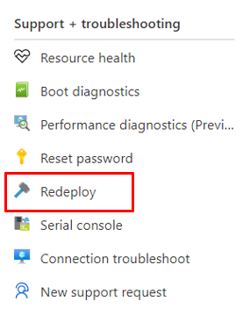
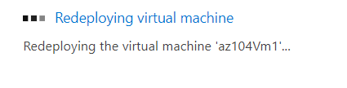
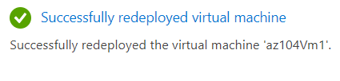
Re-Deploying Virtual Machines
When users redeploy a VM, Azure will shut down the VM, move the VM to a new node within the Azure infrastructure, and then power it back on, retaining all user configuration options and associated resources.
Notes:
If you have been facing difficulties troubleshooting Remote Desktop (RDP) connection or application access to Windows-based Azure virtual machine (VM), redeploying the VM may help.

Slide 17
Configure High Availability for Virtual Machines
Workloads are typically spread across different virtual machines to gain high throughput, performance, and to create redundancy in case a VM is impacted due to an update or other event.
Availability Sets
Availability Zones
Virtual Machines Scale Sets

Slide 18
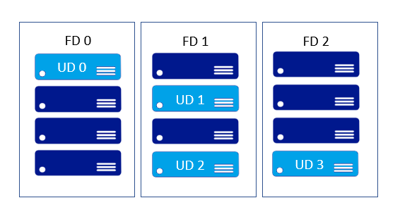
Availability Sets
An availability set is a logical grouping of the VMs in Azure, this allows the cloud to understand how a user’s application is built to provide for redundancy and availability. It’s recommended that two or more VMs are created within an availability set to provide for a highly available application and to meet the 99.95% Azure SLA.
Notes:
There is no cost for the Availability Set itself, you only pay for each VM instance that you create. When a single VM is using Azure premium SSDs, the Azure SLA applies for unplanned maintenance events.
In an availability set, VMs are automatically distributed across these fault domains. This approach limits the impact of potential physical hardware failures, network outages, or power interruptions.

Slide 19
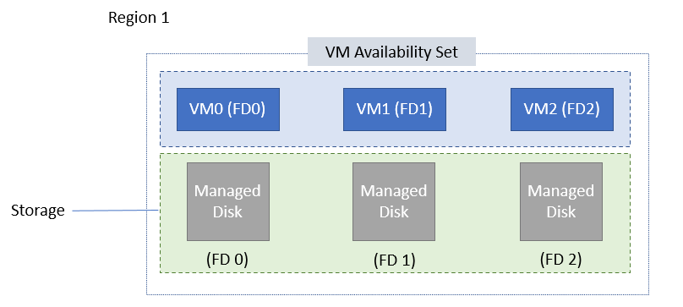
Azure Managed Disks in Availability Set
In the VMs using Azure Managed Disks, the VMs are aligned with managed disk fault domains when using a managed availability set.
This alignment ensures that all the managed disks attached to a VM are within the same managed disk fault domain.

Slide 20
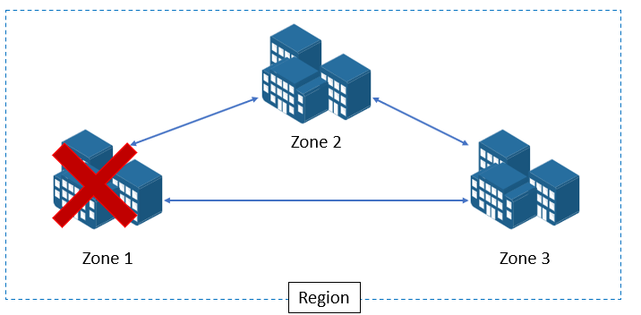
Availability Zones
An Availability Zone is a physically separate zone within an Azure region.
There are 3 Availability Zones per supported Azure region.

Slide 21
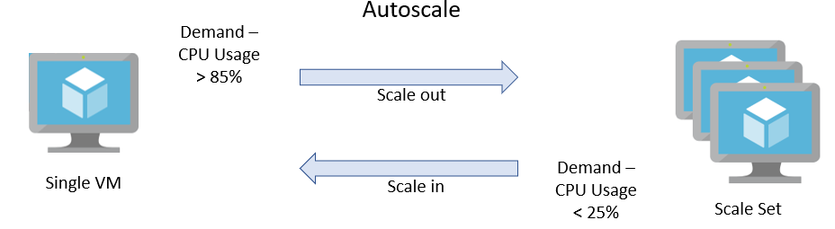
Virtual Machine Scale Sets
Azure Virtual Machine scale sets let users create and manage a group of load balanced VMs. The number of VM instances can be set to automatically increase or decrease in response to demand or a defined schedule.
Scale sets provide high availability to user applications, and allow users to centrally manage, configure, and update many VMs.

Slide 22
Lesson 2 – Automate Deployment & Configuration

Slide 23
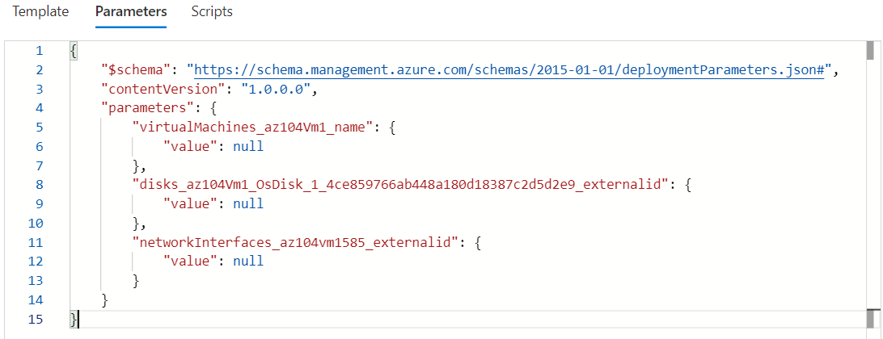
Azure Resource Management Templates
The template is a JavaScript Object Notation (JSON) file that defines the infrastructure and configuration for a user’s project. The template uses declarative syntax, which lets users state what they intend to deploy without having to write the sequence of programming commands to create it. In the template, users specify the resources to deploy and the properties for those resources.

Slide 24
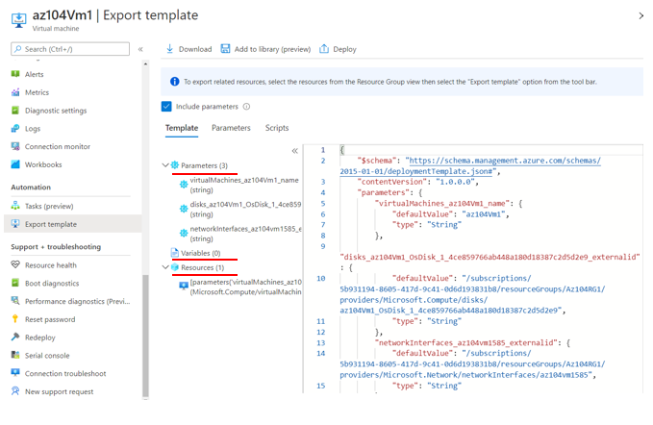
Benefits of Using ARM Templates
Declarative Syntax
Repeatable Results
Orchestration
Modular Files
Create any Azure Resource
Extensibility
Testing
Preview Changes
Built-In Validation
Tracked Deployments
CI/CD Integration
Exportable Code

Slide 25
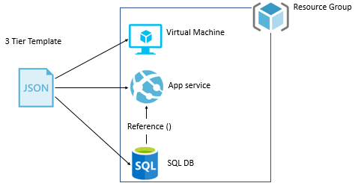
Template Design
How users define templates and resource groups is entirely up to them and how they want to manage their solution.

Slide 26
Configure VHD Template
A virtual hard disk is conceptually like a physical hard disk.
Users can use a VHD to host the operating system and run a Virtual Machine.
A VHD can also hold databases and other user-defined folders, files, and data. A VHD can hold anything that a user can store on a physical hard disk.
The difference between a VHD and a physical hard disk is that a VHD is stored as a virtual file in Azure. It isn't a piece of physical hardware.

Slide 27
VHDs Advantages
High Availability
Physical Security
Durability
Scalability
Cost and Performances

Slide 28
Prepare a Windows VHD or VHDX to Upload to Azure
Before users upload a Windows Virtual Machine (VM) from on-premises to Azure, they must prepare the virtual hard disk (VHD or VHDX).
Run Windows System File Checker Utility Before Generalization of OS Image
Set Windows Configurations for Azure
Check the Windows Services
Update Remote Desktop Registry Settings
Configure Windows Firewall Rules
Verify the VM
Generalize a VHD
Convert the Virtual Disk to a Fixed Size VHD
Use Hyper-V Manager to Convert the Disk
Notes:
Azure supports both generation 1 and generation 2 VMs that are in VHD file format and that have a fixed-size disk.

Slide 29
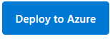
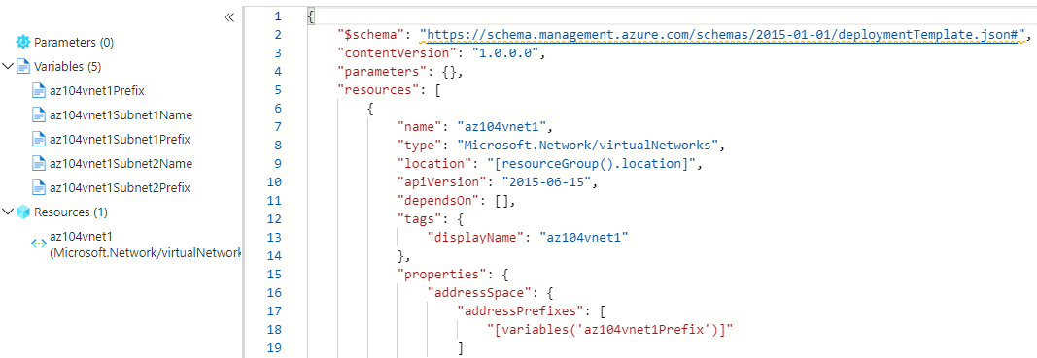
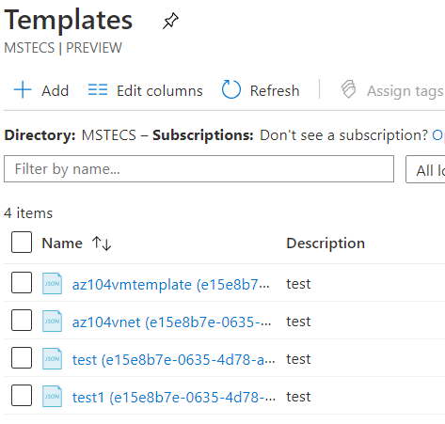
Deploying from Templates
Users can deploy resources in Azure from templates that they have saved from previous deployments into the Templates service, they can select Quick Templates, or they can run templates using files uploaded into Cloud Shell.

Slide 30
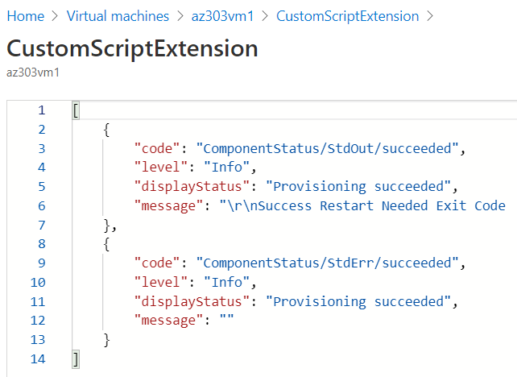
Automate Configurations Using Custom Script Extensions
The Custom Script Extension downloads and executes scripts on Azure Virtual Machines. This extension is useful for post deployment configuration, software installation, or any other configuration or management tasks.

Slide 31
Lesson 3 – Creating & Configuring Containers

Slide 32
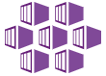
Azure Kubernetes Service – AKS
AKS is an orchestrator that simplifies the task to deploy a managed Kubernetes cluster in Azure.
AKS reduces the complexity and operational overhead of managing Kubernetes by offloading much of that responsibility to Azure.

Slide 33
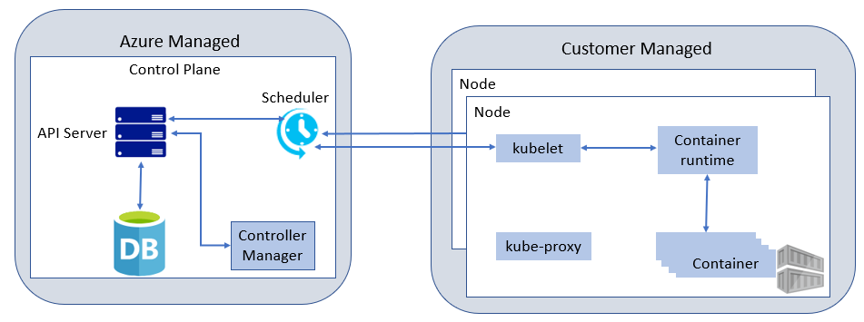
AKS – Clusters and Nodes
AKS nodes run on Azure Virtual Machines.
Users can connect storage to nodes and pods, upgrade cluster components, use GPUs Linux nodes to run a customized Ubuntu OS image, and Windows Server nodes run a customized Windows Server 2019 OS image.
Notes:
AKS supports Kubernetes clusters that run multiple node pools to support mixed operating systems and Windows Server containers.

Slide 34
AKS – Nodes and Node Pools
To run applications and supporting services, users need a Kubernetes node. An AKS cluster has one or more nodes, which is an Azure Virtual Machine (VM) that runs the Kubernetes node components and container runtime.
Kubelet
Kube-Proxy
Container Runtime

Slide 35
AKS – Pods
The pods run an instance of the user’s application. A pod represents a single instance of the application. Pods typically have a 1:1 mapping with a container, although there are advanced scenarios where a pod may contain multiple containers.
These multi-container pods are scheduled together on the same node and allow containers to share related resources.

Slide 36
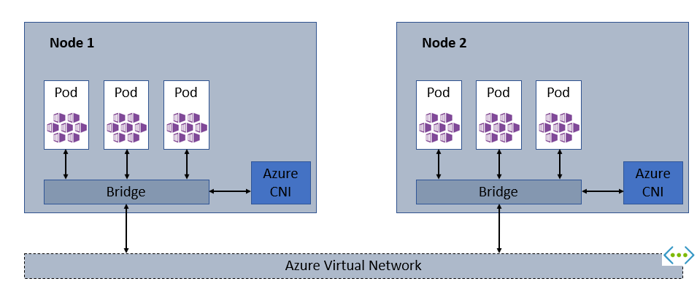
AKS – Networking
Kubernetes nodes are connected to a virtual network and can provide inbound and outbound connectivity for pods. The kube-proxy component runs on each node to provide these network features.

Slide 37
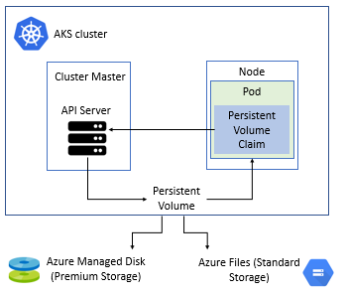
AKS – Storage
Applications that run in Azure Kubernetes Service (AKS) may need to store and retrieve data.
Multiple pods may need to share the same data volumes or reattach data volumes if the pod is rescheduled on a different node.

Slide 38
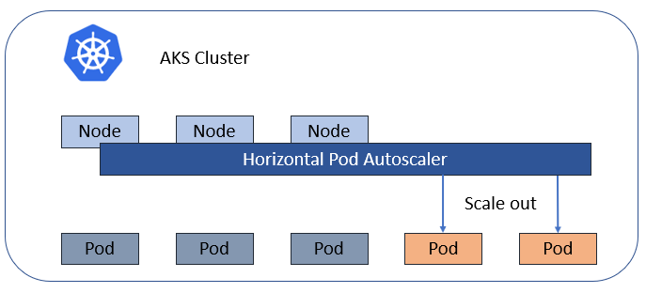
AKS – Scaling
As users run applications in Azure Kubernetes Service (AKS), they may need to increase or decrease the amount of compute resources.
As the number of application instances users need to change adjusts, they many need to modify the number of underlying Kubernetes nodes.

Slide 39
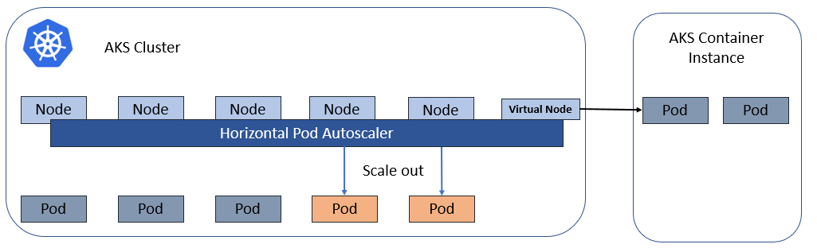
AKS – Scaling to ACI
To rapidly scale AKS clusters, users can integrate with Azure Container Instances (ACI).

Slide 40
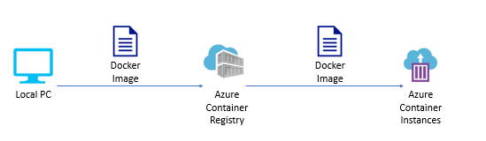
Azure Container Instances – ACI
Azure Container Instances are a great solution for any scenario that can operate in isolated containers, including simple applications, task automation, and build jobs.

Slide 41
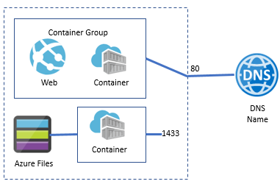
Container Groups
A container group is a collection of containers that get scheduled on the same host machine.
The containers in a container group share a lifecycle, resources, local network, and storage volumes.

Slide 42
Lesson 4 – Web Apps

Slide 43

Azure App Service
In App Service (Web Apps, API Apps, or Mobile Apps), the app always runs in an App Service plan.
In addition, Azure Functions also has the option of running in an App Service Plan. An App Service Plan defines a set of compute resources for a web app to run. These compute resources are analogous to the server farm in conventional web hosting.

Slide 44



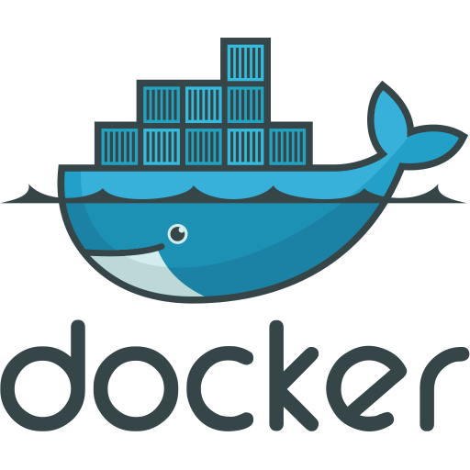
Key Features of App Service
Multiple Languages and Frameworks
Managed Production Environment
Containerization and Docker
DevOps Optimization
Global Scale with High Availability
Connections to SaaS Platforms and On-Premises Data
Security and Compliance
Application Templates
API and Mobile Features

Slide 45
Limitations
App Service on Linux is not supported on Shared Pricing Tier.
Users can't mix Windows and Linux apps in the same App Service Plan.
Within the same resource group, users can't mix Windows and Linux apps in the same region.
The Azure portal only shows features that currently work for Linux apps. As features are enabled, they're activated in the portal.

Slide 46
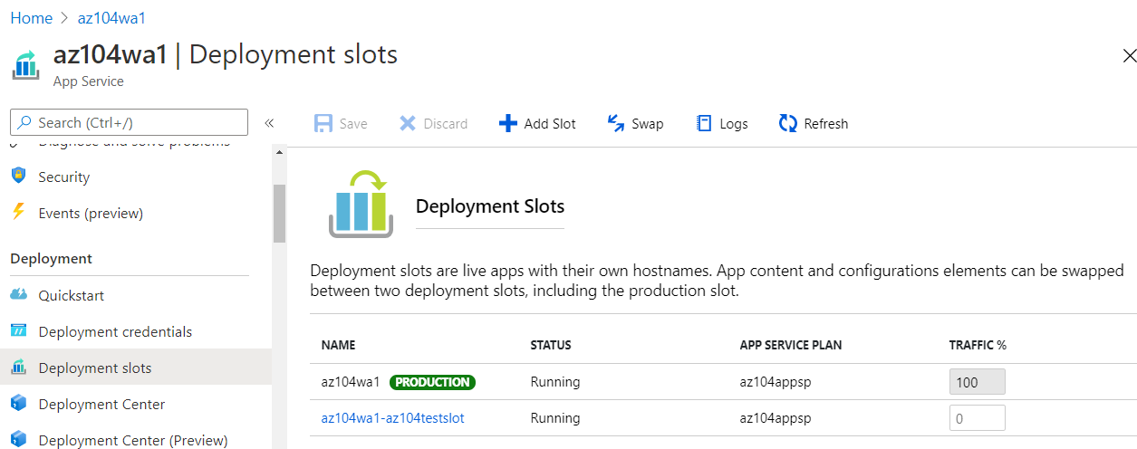
Deployment Slots
Deployment slots are live apps with their own host names.
App content and configurations elements can be swapped between two deployment slots – including the production slot.

Slide 47
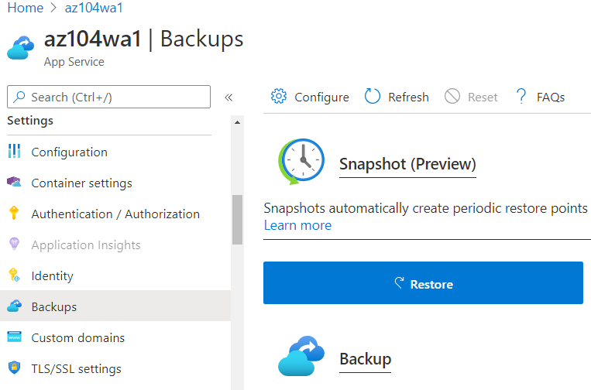
Back Up an App Service
The Back Up and Restore feature in Azure App Service lets users easily create app backups (manually or on a schedule).
Users can configure the backups to be retained up to an indefinite amount of time.
Notes:
You can restore the app to a snapshot of a previous state by overwriting the existing app or restoring to another app.

Slide 48
Azure App Service Plan
Azure App Service is an HTTP-based service for hosting web applications, REST APIs, and mobile back ends.
Users can develop in their favorite language, be it .NET, .NET Core, Java, Ruby, Node.js, PHP, or Python.
Applications run and scale with ease on both Windows and Linux-based environments.

Slide 49
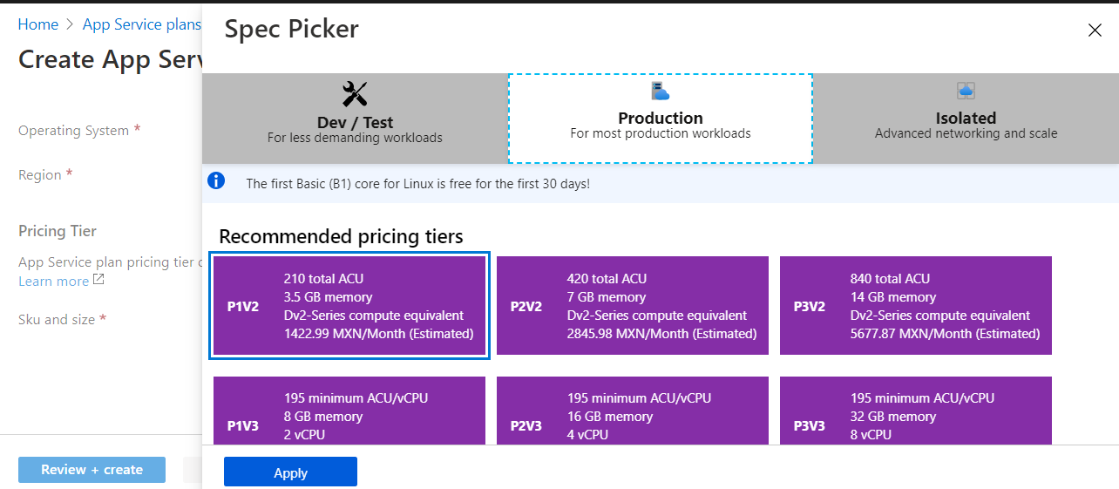
App Service Plan Tiers
The pricing tier of an App Service Plan determines what App Service features users get and how much they pay for the plan. There are a few categories of pricing tiers:
Shared Compute: Free and Shared
Dedicated Compute: Basic, Standard, Premium, PremiumV2, and PremiumV3
Isolated

Slide 50
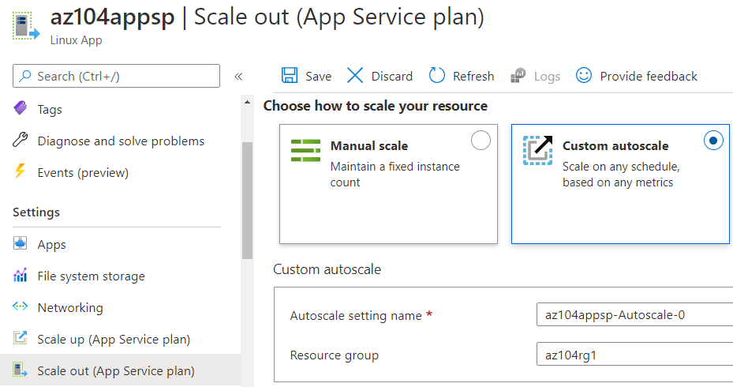
App Service Plan Scaling
Users can Scale their App Service Plan, there are 2 Workflows for Scaling:
Scale Up: Get more CPU, memory, disk space, and extra features.
Scale Out: Increase the number of VM instances that run the user app.
Notes:
Scale out - You can scale out to as many as 30 instances, depending on your pricing tier. App Service Environments in Isolated tier further increases your scale-out count to 100 instances

